Slide 1
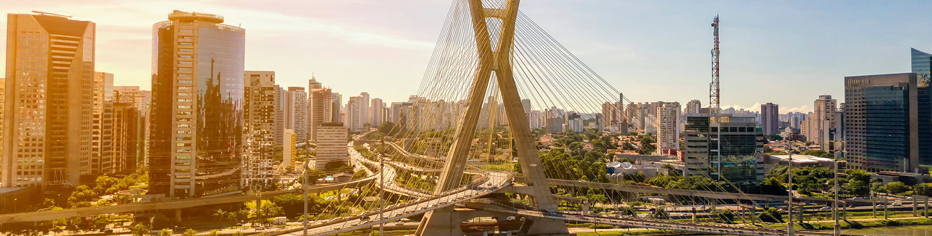

MODFLOW 6 Advanced Packages
47TH IAH Congress
São Paulo, Brazil
August 22, 2021
Notes:
Describe some of the ongoing work we are doing with MODFLOW
MODFLOW and related software distributed by the USGS is developed and supported by a growing team of USGS scientists and external collaborators. Recent MODFLOW development efforts have focused on use of unstructured and locally refined grids for constant or variable-density groundwater flow and solute transport simulation, robust handling of three-dimensional anisotropy, generalization and tracking of water transfer between packages, distributed memory parallelization, and consolidation of these core capabilities into MODFLOW 6. These capabilities make it possible to construct new types of models, such as tightly coupled nested models, that have not been possible with previous MODFLOW versions. Underlying these efforts has been the adoption of an open-development philosophy that relies on testing-based development and continuous integration practices by the core development team and by the broader MODFLOW community. Ongoing development increasingly relies on the Flopy python package for automating model construction. Resulting from these development efforts is a suite of MODFLOW programs that can be applied at local, regional, and National scales for a wide variety of complex groundwater flow and transport problems.
OASIS MCT

Slide 2
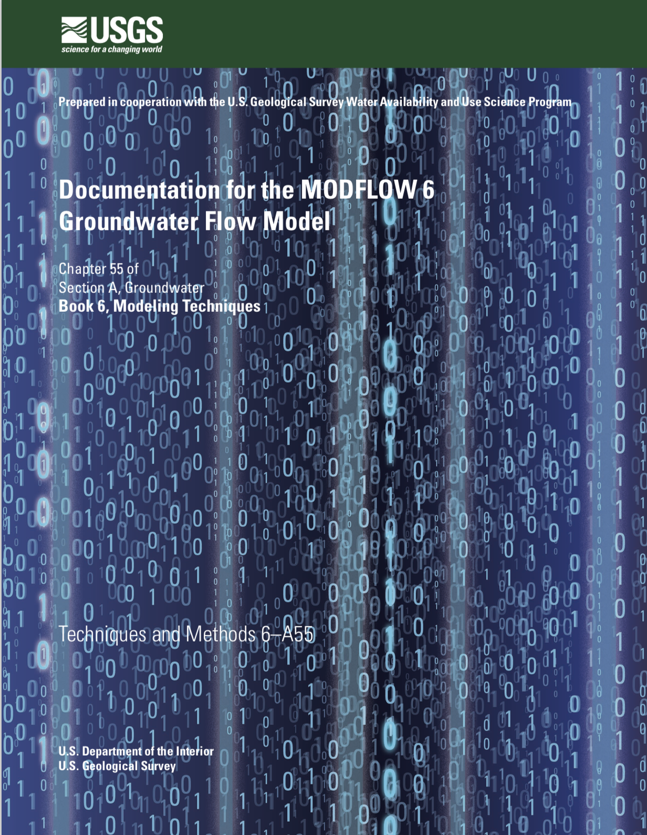

GWF Documentation

Slide 3
Advanced packages

Slide 4
Advanced Packages
Multi-Aquifer Well (MAW) Package
Stream-Flow Routing (SFR) Package
Lake (LAK) Package
Unsaturated Zone Flow (UZF) Package
Water Mover (MVR) Package

Slide 5
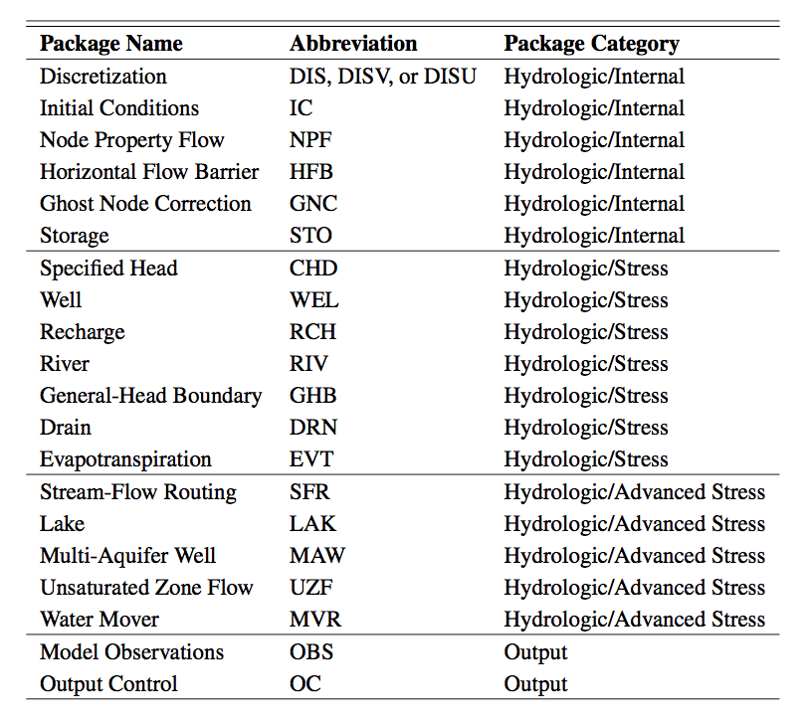
All GWF Packages

Slide 6
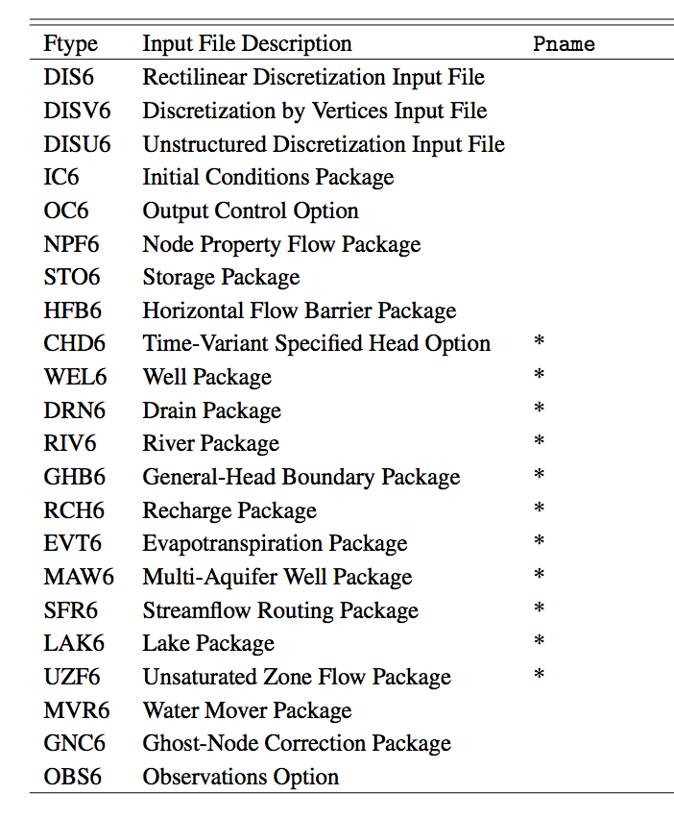
Multiple Package of Same Type

Slide 7
Advanced Stress Packages
Solve a separate continuity equation*
Require discretization definition*
Require parameter definition
Require connectivity definition
Require specification of boundary stresses*
Separate budgets and output files
*does not apply to Mover (MVR) package

Slide 8
Multi-Aquifer Well Package

Slide 9
MAW6 Package Capabilities
Capabilities
Solved as part of the matrix solution
Simplified data input
Flexible connectivity
Several well conductance formulations
Constraints (flow reduction and well shutdown) and flowing well options
Can account for interbore storage changes
Constant and inactive wells
Differences
No support for
horizontal wells
partial penetration
non-linear head losses

Slide 10
MAW6 Package Input
BEGIN OPTIONS
PRINT_INPUT
PRINT_FLOWS
BOUNDNAMES
TS6 FILEIN maw_rates.ts
OBS6 FILEIN maw.obs
NO_WELL_STORAGE
end options
BEGIN DIMENSIONS
NMAWWELLS 1
END DIMENSIONS
BEGIN PACKAGEDATA
# NO RADIUS BOTTOM STRT CONDEQN NGWNODES AUX1 AUX2 NAME
1 0.15 -514.9 9.14 SPECIFIED 2 100 1.0 NTWELL
END PACKAGEDATA
BEGIN CONNECTIONDATA
# CONN L R C STOP SBOT K RSKIN
1 1 1 51 51 -50 -514.9 111.53 0
1 2 2 51 51 -50 -514.9 446.62 0
END CONNECTIONDATA
BEGIN PERIOD 1
1 RATE MAWQ1
END PERIOD

Slide 11
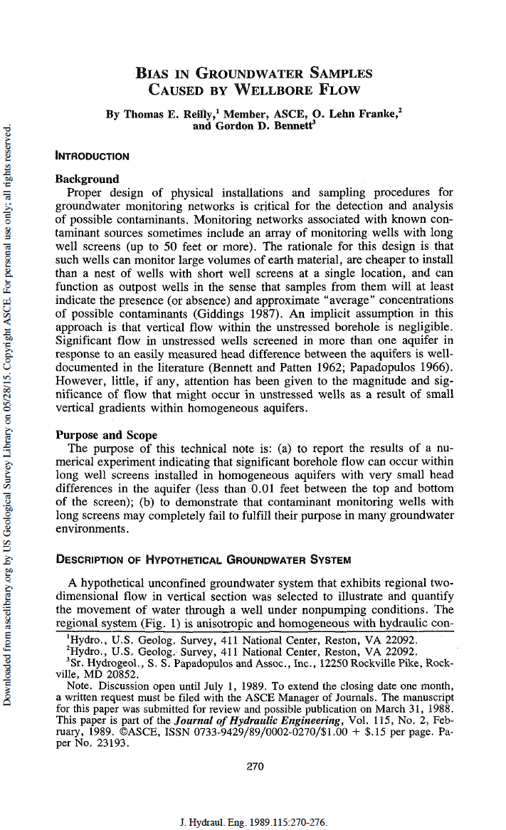
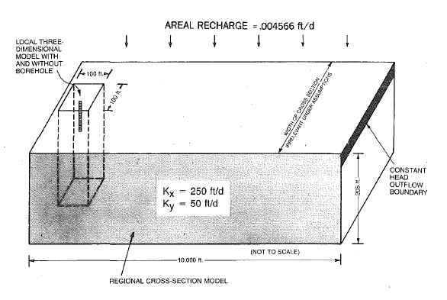
MAW6 Package

Slide 12
Advanced (MAW6) Package Output
MAW-NT_WELL BUDGET FOR ENTIRE MODEL AT END OF TIME STEP 50, STRESS PERIOD 3
------------------------------------------------------------------------------
CUMULATIVE MAW-NT_WELL L**3 RATES FOR THIS TIME STEP L**3/T
------------------ ------------------------
IN: IN:
--- ---
GWF = 32931.1497 GWF = 2767.0000
RATE = 0.0000 RATE = 0.0000
CONSTANT = 0.0000 CONSTANT = 0.0000
TOTAL IN = 32931.1497 TOTAL IN = 2767.0000
OUT: OUT:
---- ----
GWF = 1170.8715 GWF = 0.0000
RATE = 31760.2781 RATE = 2767.0000
CONSTANT = 0.0000 CONSTANT = 0.0000
TOTAL OUT = 32931.1497 TOTAL OUT = 2767.0000
IN - OUT = 3.8031E-07 IN - OUT = 4.3552E-08
PERCENT DISCREPANCY = 0.00 PERCENT DISCREPANCY = 0.00

Slide 13
Advanced (MAW6) Package Output
MULTI-AQUIFER WELL (MAW-NT_WELL) HEAD PERIOD 3 STEP 50
----------------------------------
WELL WELL WELL
NAME NO. HEAD
----------------------------------
NTWELL 1 0.2729
MULTI-AQUIFER WELL (MAW-NT_WELL) FLOWS PERIOD 3 STEP 50
------------------------------------------------------------------------------------------
WELL WELL GWF GWF WELL CONSTANT WELL PERCENT
NAME NO. IN OUT RATE FLOW IN - OUT DIFFERENCE
------------------------------------------------------------------------------------------
NTWELL 1 2767. 0.000 -2767. 0.000 0.4355E-07 0.1574E-08

Slide 14
Unsaturated Zone Flow Package

Slide 15
UZF6 Package
Intended for basin scale studies
Simulates:
ET (unsaturated and saturated)
Spring discharge (groundwater discharge to land surface)
Saturation excess (rejected infiltration)

Slide 16
UZF6 Package
Kinematic-wave Equation for vertical unsaturated flow provides a solution for gravity flow with internal drainage.
Internal drainage

Slide 17
UZF6 Package
Brooks-Corey Equation
Required input variables

Slide 18
UZF6 Package
Micro Topography Solves Infiltration/Discharge Discontinuity Problem
Head/Elevation
Head/Elevation
Recharge
Recharge
Problem!
Smooth
0.0
0.0
Discharge
Discharge
Land surface
Land surface
No micro topography
With micro topography

Slide 19
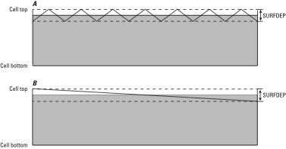
UZF6 Package
Groundwater Discharge—Water Table is Close to Land Surface

Slide 20
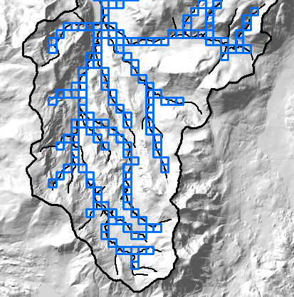
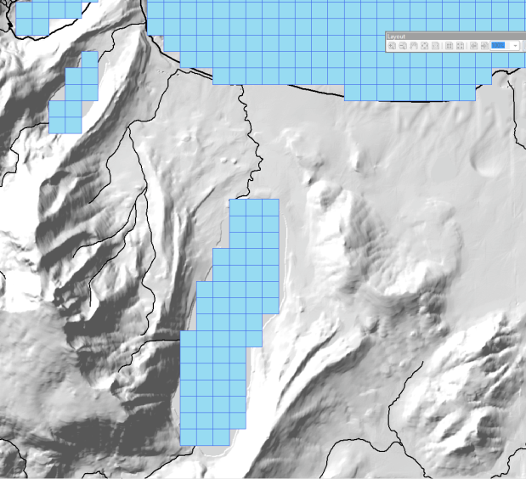
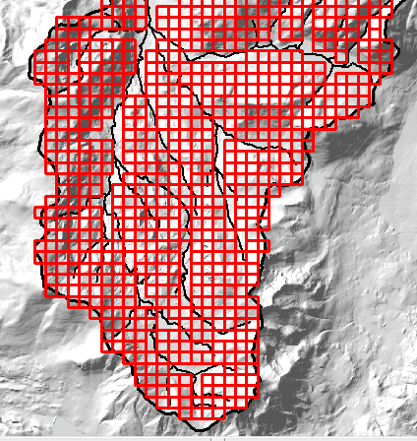
UZF6 Package
UZF model 1
UZF model 2
UZF model 3
Stream seepage
Ponds/lakes
Mountain slope

Slide 21
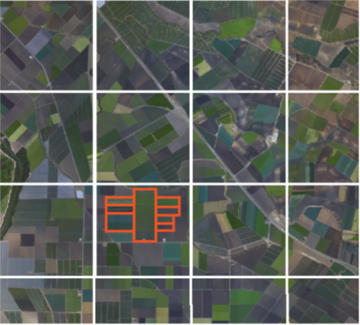
UZF6 Package
Coarse GWF grid
UZF cells correspond to GWF grid in areas with less data
UZF cells corresponding to different land use types

Slide 22
UZF6 Package Input
BEGIN OPTIONS
BOUNDNAMES
PRINT_INPUT
PRINT_FLOWS
SAVE_FLOWS
SIMULATE_ET
LINEAR_GWET
SIMULATE_GWSEEP
MOVER
OBS6 FILEIN uzfp3_lakmvr_v2_uzf.obs
BUDGET FILEOUT uzf.cbc
END OPTIONS
BEGIN DIMENSIONS
NUZFCELLS 200
NTRAILWAVES 10
NWAVESETS 50
END DIMENSIONS
BEGIN PACKAGEDATA
# NO CELLID LFLG VCON SURFDEP VKS THTR THTS THTI EPS BOUNDANAME
1 1 1 1 1 101 0.1 1.00E-06 0.1 0.3 0.11 3.5 uzfcells
2 1 1 2 1 102 0.1 1.00E-06 0.1 0.3 0.11 3.5 uzfcells
3 1 2 1 1 103 0.1 1.00E-06 0.2 0.3 0.21 3.5 uzfcells
--- DELETED INPUT ---

Slide 23
UZF6 Package Input
--- DELETED INPUT ---
198 2 15 4 0 0 0.1 1.00E-06 0.2 0.3 0.21 3.5 uzfcells
199 2 15 5 0 0 0.1 1.00E-06 0.2 0.3 0.21 3.5 uzfcells
200 2 15 6 0 0 0.1 1.00E-06 0.2 0.3 0.21 3.5 uzfcells
END PACKAGEDATA
BEGIN PERIOD 1
# uzfid finf pet extdp extwc ha hroot rootact
1 3.34E-10 1.00E-08 15 0.100005 0.0 0.0 0.0
2 6.68E-10 1.00E-08 15 0.100005 0.0 0.0 0.0
3 6.68E-10 1.00E-08 15 0.20001 0.0 0.0 0.0
--- DELETED INPUT ---
98 2.68E-09 1.00E-08 15 0.20001 0.0 0.0 0.0
99 2.68E-09 1.00E-08 15 0.20001 0.0 0.0 0.0
100 2.68E-09 1.00E-08 15 0.20001 0.0 0.0 0.0
END PERIOD

Slide 24
Streamflow Routing Package

Slide 25
SFR6 Package

Slide 26
SFR6 Package Capabilities
Capabilities
multiple diversions from a single reach
downstream outflow from a reach to multiple segments using user-specified time-varying discharge fractions.
diversion priority scheme can be implemented based on diversion order
Inactive reaches
rectangular reaches
stream data are specified by reach
explicitly defined reach connectivity
currently no UZF under reaches
no Kinematic Routing (no reach storage changes)

Slide 27
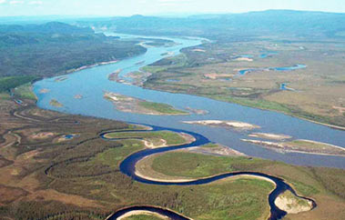
SFR6 Package Continuity Equation

Slide 28
SFR6 Package Connectivity

Slide 29
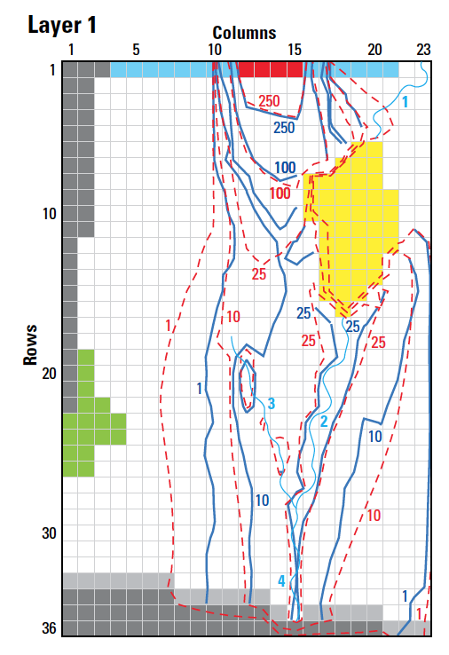
SFR6 Package Input
BEGIN OPTIONS
PRINT_STAGE
PRINT_FLOWS
UNIT_CONVERSION 128390.00
MOVER
SAVE_FLOWS
STAGE FILEOUT mf6-gwt.sfr.stage.bin
BUDGET FILEOUT mf6-gwt.sfr.cbc
END OPTIONS
BEGIN DIMENSIONS
NREACHES 38
END DIMENSIONS
BEGIN PACKAGEDATA
#RNO CELLID RLEN RWID RGRD RBTP RBTH RBHK MAN NCON USTRF NDV
1 1 1 23 400.0000 5.000000 0.1818182E-02 48.63636 1.000000 100.0000 0.3000000E-01 1 1.0000 0
2 1 2 23 200.0000 5.000000 0.1818182E-02 48.09091 1.000000 100.0000 0.3000000E-01 2 1.0000 0
3 1 2 22 400.0000 5.000000 0.1818182E-02 47.54546 1.000000 100.0000 0.3000000E-01 2 1.0000 0
4 1 3 21 400.0000 5.000000 0.1818182E-02 46.81818 1.000000 100.0000 0.3000000E-01 2 1.0000 0
5 1 4 20 400.0000 5.000000 0.1818182E-02 46.09091 1.000000 100.0000 0.3000000E-01 2 1.0000 0
6 1 5 20 400.0000 5.000000 0.1818182E-02 45.36364 1.000000 100.0000 0.3000000E-01 1 1.0000 0
7 1 17 18 400.0000 5.000000 0.2187500E-02 44.06250 1.000000 100.0000 0.3000000E-01 1 1.0000 0
8 1 18 18 400.0000 5.000000 0.2187500E-02 43.18750 1.000000 100.0000 0.3000000E-01 2 1.0000 0
9 1 19 18 400.0000 5.000000 0.2187500E-02 42.31250 1.000000 100.0000 0.3000000E-01 2 1.0000 0
10 1 20 17 400.0000 5.000000 0.2187500E-02 41.43750 1.000000 100.0000 0.3000000E-01 2 1.0000 0
11 1 21 17 400.0000 5.000000 0.2187500E-02 40.56250 1.000000 100.0000 0.3000000E-01 2 1.0000 0
12 1 22 17 400.0000 5.000000 0.2187500E-02 39.68750 1.000000 100.0000 0.3000000E-01 2 1.0000 0
--- DELETED INPUT ---

Slide 30
SFR6 Package Input – cont.
--- DELETED INPUT ---
32 1 29 15 400.0000 5.000000 0.2428571E-02 33.51429 1.000000 100.0000 0.3000000E-01 3 1.0000 0
33 1 30 15 400.0000 5.000000 0.2428571E-02 32.54286 1.000000 100.0000 0.3000000E-01 2 1.0000 0
34 1 31 15 400.0000 5.000000 0.2428571E-02 31.57143 1.000000 100.0000 0.3000000E-01 2 1.0000 0
35 1 32 15 400.0000 5.000000 0.2428571E-02 30.60000 1.000000 100.0000 0.3000000E-01 2 1.0000 0
36 1 33 15 400.0000 5.000000 0.2428571E-02 29.62857 1.000000 100.0000 0.3000000E-01 2 1.0000 0
37 1 34 15 400.0000 5.000000 0.2428571E-02 28.65714 1.000000 100.0000 0.3000000E-01 2 1.0000 0
38 1 35 15 400.0000 5.000000 0.2428571E-02 27.68571 1.000000 100.0000 0.3000000E-01 1 1.0000 0
END PACKAGEDATA
BEGIN CONNECTIONDATA
1 -2
2 1 -3
3 2 -4
4 3 -5
5 4 -6
6 5
7 -8
8 7 -9
9 8 -10
10 9 -11
11 10 -12
12 11 -13
13 12 -14
14 13 -15
15 14 -16
16 15 -17
17 16 -18
--- DELETED INPUT ---

Slide 31
SFR6 Package Input
--- DELETED INPUT ---
19 -20
20 19 -21
21 20 -22
22 21 -23
23 22 -24
24 23 -25
25 24 -26
26 25 -27
27 26 -28
28 27 -29
29 28 -30
30 29 -31
31 30 -32
32 18 31 -33
33 32 -34
34 33 -35
35 34 -36
36 35 -37
37 36 -38
38 37
END CONNECTIONDATA
BEGIN PERIOD 1
1 INFLOW 86400.000
END PERIOD
BEGIN PERIOD 2
1 INFLOW 95040.
END PERIOD

Slide 32
Lake Package

Slide 33
LAK6 Package Capabilities
Capabilities
multiple outlets per lake using 3 outlet equation options (specified, Manning, weir)
lakes on top of model (overlying), incised lakes, embedded lakes (sub-grid scale lakes)
constant stage and inactive lakes
explicitly defined lake connectivity
currently no UZF under lakes

Slide 34
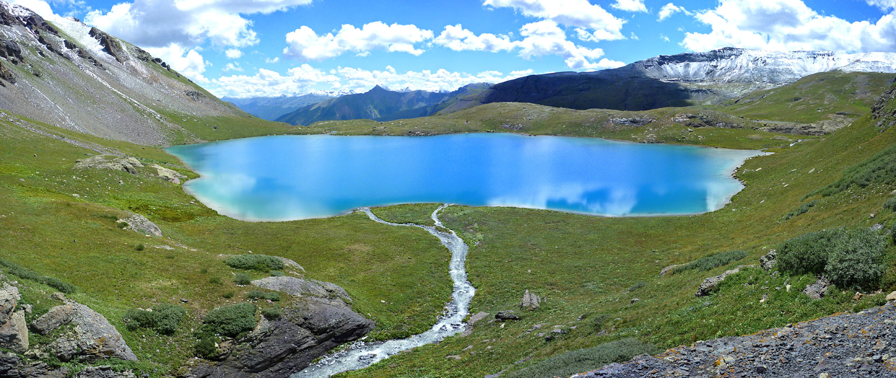
LAK6 Package Continuity Equation

Slide 35
LAK6 Package Input
BEGIN Options
PRINT_INPUT
PRINT_STAGE
PRINT_FLOWS
SAVE_FLOWS
STAGE FILEOUT mf6-gwt.lak.stage.bin
BUDGET FILEOUT mf6-gwt.lak.cbc
MOVER
DEV_GROUNDWATER_HEAD_CONDUCTANCE
TIME_CONVERSION 86400.000
END Options
BEGIN DIMENSIONS
NLAKES 2
NOUTLETS 1
END DIMENSIONS
BEGIN PACKAGEDATA
# LAKENO STRT NLAKECONN
1 44.000000 78
2 35.200001 32
END PACKAGEDATA
BEGIN CONNECTIONDATA
# LAKENO ICONN CELLID CLAKTYPE BEDLEAK BELEV TELEV CONNLEN CONNWIDTH
1 1 1 5 19 HORIZONTAL 1.000000 0.000000 0.000000 201.8585 405.6650
1 2 1 5 20 HORIZONTAL 1.000000 0.000000 0.000000 201.8585 405.6650
1 3 1 6 18 HORIZONTAL 1.000000 0.000000 0.000000 202.8325 403.7170
1 4 1 6 18 HORIZONTAL 1.000000 0.000000 0.000000 201.8585 405.6650
--- DELETED INPUT ---

Slide 36
LAK6 Package Input
--- DELETED INPUT ---
2 22 2 23 2 VERTICAL 1.000000 0.000000 0.000000 0.000000 0.000000
2 23 2 23 3 VERTICAL 1.000000 0.000000 0.000000 0.000000 0.000000
2 24 2 23 4 VERTICAL 1.000000 0.000000 0.000000 0.000000 0.000000
2 25 2 24 1 VERTICAL 1.000000 0.000000 0.000000 0.000000 0.000000
2 26 2 24 2 VERTICAL 1.000000 0.000000 0.000000 0.000000 0.000000
2 27 2 24 3 VERTICAL 1.000000 0.000000 0.000000 0.000000 0.000000
2 28 2 24 4 VERTICAL 1.000000 0.000000 0.000000 0.000000 0.000000
2 29 2 25 1 VERTICAL 1.000000 0.000000 0.000000 0.000000 0.000000
2 30 2 25 2 VERTICAL 1.000000 0.000000 0.000000 0.000000 0.000000
2 31 2 26 1 VERTICAL 1.000000 0.000000 0.000000 0.000000 0.000000
2 32 2 26 2 VERTICAL 1.000000 0.000000 0.000000 0.000000 0.000000
END CONNECTIONDATA
BEGIN OUTLETS
# OUTLETNO LAKEIN LAKEOUT COUTTYPE INVERT WIDTH ROUGH SLOPE
1 1 0 MANNING 44.5 5.000000 0.30000000E-01 0.2187500E-02
END OUTLETS
BEGIN PERIOD 1
1 RAINFALL 0.0000000
1 EVAPORATION 0.0000000
1 RUNOFF 0.0000000
1 WITHDRAWAL 0.0000000
2 RAINFALL 0.0000000
2 EVAPORATION 0.0000000
2 RUNOFF 0.0000000
2 WITHDRAWAL 0.0000000
END PERIOD

Slide 37
Mover Package

Slide 38
MVR6 Package
CONSTRAINTS
PROVIDER
RECEIVER
Package
Discharge
One to One
Provider 1
Receiver 1
One to Many
Receiver 2
Provider 2
Receiver 3
Many to One
Provider 3
Receiver 4
Provider 4

Slide 39
MVR6 Package Constraints
Fraction
Discharge x fraction is sent to the receiver
Excess
Any water that exceeds the user-specified rate is provided to the receiver. No water is provided to the receiver if the available water is less than the user-specified value. (Flood control)

Slide 40
MVR6 Package Constraints
Threshold
No flow is provided to the receiver until the available water exceeds the user-specified rate. Once the available water exceeds the user-specified rate, then the user-specified rate is provided to the receiver. (Priority)
Up To
All of the available water will be taken from the provider up to the user-specified rate. Once user-specified rate is exceeded, the receiver will continue to get the user-specified rate.

Slide 41
MVR6 Package
Provider
Drain package
General-head boundary package
River package
Well package
Provider and Receiver
Lake package
Multi-aquifer well package
Streamflow routing package
Unsaturated zone package
Available water for mover is reduced by multiple receivers with the same provider in order listed in Mover package

Slide 42
MVR6 Package Input
BEGIN OPTIONS
PRINT_INPUT
PRINT_FLOWS
BUDGET FILEOUT mvr.cbc
END OPTIONS
BEGIN DIMENSIONS
MAXMVR 3
MAXPACKAGES 2
END DIMENSIONS
BEGIN PACKAGES
SFR-1
LAK-1
END PACKAGES
BEGIN PERIOD 1
SFR-1 6 LAK-1 1 FACTOR 1.000000000000000
LAK-1 1 SFR-1 7 FACTOR 1.000000000000000
END PERIOD

Slide 43
MVR6 Package Output
WATER MOVER BUDGET FOR ENTIRE MODEL AT END OF TIME STEP 1, STRESS PERIOD 1
------------------------------------------------------------------------------
CUMULATIVE WATER MOVER L**3 RATES FOR THIS TIME STEP L**3/T
------------------ ------------------------
IN: IN:
--- ---
SFR-1 = 873431546.1767 SFR-1 = 191332.2116
LAK-1 = 1229229296.0636 LAK-1 = 269272.5731
TOTAL IN = 2102660842.2403 TOTAL IN = 460604.7847
OUT: OUT:
---- ----
SFR-1 = 1229229296.0636 SFR-1 = 269272.5731
LAK-1 = 873431546.1767 LAK-1 = 191332.2116
TOTAL OUT = 2102660842.2403 TOTAL OUT = 460604.7847
IN - OUT = 0.0000 IN - OUT = 0.0000
PERCENT DISCREPANCY = 0.00 PERCENT DISCREPANCY = 0.00

Slide 44
QUESTIONS?

